Slide 1
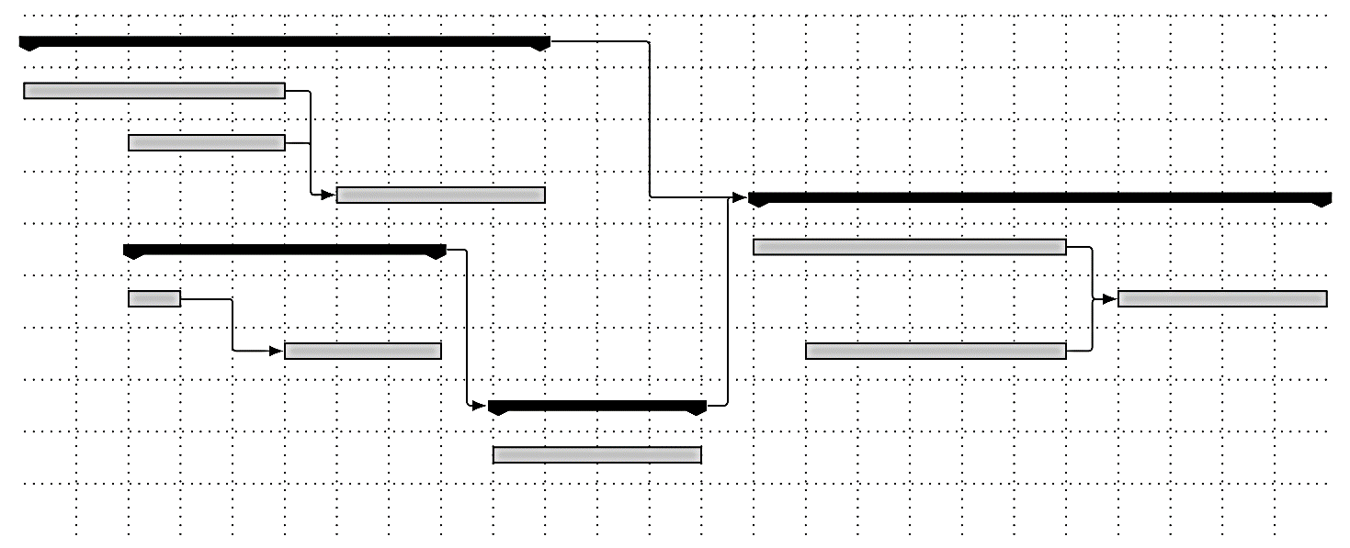
SWOP – TaskMan iteratie 3
Door Tim Van Den Broecke,
Joran Van de Woestijne,
Vincent Van Gestel en
Eli Vangrieken

Slide 2
Inleiding
Refactoring iteratie 2
Design overzicht
Branch Representative in detail
Use-Cases
Testing

Slide 3
Inleiding
Refactoring iteratie 2
Design overzicht
Branch Representative in detail
Use-Cases
Testing

Slide 4
Refactoring Iteratie 2 - Exceptions

Slide 5
Refactoring Iteratie 2 - Protected

Slide 6
Inleiding
Refactoring iteratie 2
Design overzicht
Branch Representative in detail
Use-Cases
Testing

Slide 7
Design overzicht - Elementen

Slide 8
Design overzicht - Classes

Slide 9
Inleiding
Refactoring iteratie 2
Design overzicht
Branch Representative in detail
Use-Cases
Testing

Slide 10
Branch Representative - Proxies

Slide 11
Branch Representative - Buffer

Slide 12
Inleiding
Refactoring iteratie 2
Design overzicht
Branch Representative in detail
Use-Cases
Testing

Slide 13
HEEL VEEL PRENTJES

Slide 14
Inleiding
Refactoring iteratie 2
Design overzicht
Branch Representative in detail
Use-Cases
Testing

Slide 15
Testing - Testsuite
Demonstratie

Slide 16
Werkverdeling
Format: (Estimated) group / individual / study
Vincent Van Gestel: Design coordinator now
(40ish?)/12/8
Joran Van de Woestijne: Testing coordinator now
?/?/?
Tim Van Den Broecke: Wildcard now
?/?/?
Eli Vangrieken: Domain coordinator now
?/?/?

